Slide 1
Digital Circuits and Systems Lecture 8 Model Dapath FSM
Tian Sheuan Chang
FSM 百百種，但大部分的next state 用counter 類簡單計算就可以，不用table

Slide 2
Outline [Dally ch. 16]
Counter
Simple counter, up down counter
Shift register
Datapath and control partitioning
Vending machine example

Slide 3
Counter as FSM Counter 當FSM控制

Slide 4
An FSM is a state register and two functions

Slide 5

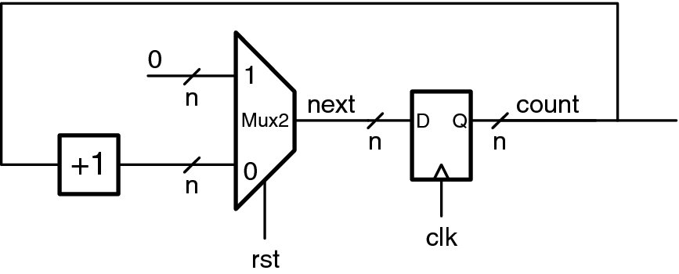
Counter 當FSM
Suppose you want to build an FSM with the following state diagram

Slide 6
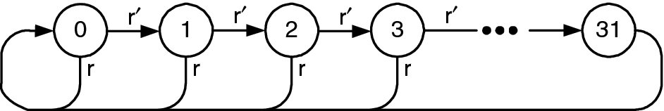
第一種寫法: 表格式 Table based
module Counter1(clk,rst,out) ;
input rst, clk ; // reset and clock
output [4:0] out ;
reg [4:0] next ;
DFF #(5) count(clk, next, out) ;//5-bit counter
always_comb begin //any change
casez({rst,out})
6'b1?????: next = 0 ;
6'd0: next = 1 ;
6'd1: next = 2 ;
6'd2: next = 3 ;
…
6'd30: next = 31 ;
6'd31: next = 0 ;
default: next = 0 ;
endcase
end
endmodule
State | Next State
 | ~rst | rst
0 | 1 | 0
1 | 2 | 0
2 | 3 | 0
. . .
30 | 31 | 0
31 | 0 | 0
表格很好，但這個變化很規則，可以更簡單描述
next = r ? 0 : state + 1 ;
Notes:
Cost 15*mux cost*5
Mux cost = 2
15*5*2 = 150

Slide 7
第二種寫法: 用算數作FSM Datapath FSM
module Counter(clk, rst, count) ;
parameter n=5 ;
input rst, clk ; // reset and clock
output [n-1:0] count ;
wire [n-1:0] next = rst? 0 : count + 1 ;
DFF #(n) count(clk, next, count) ;
endmodule
Notes:
5*7 = 35

Slide 8
Make Table Symbolic
State | Next State
 | ~rst | rst
0 | 1 | 0
1 | 2 | 0
2 | 3 | 0
. . .
30 | 31 | 0
31 | 0 | 0
State | Next State
 | ~rst | rst
a | a+1 | 0

Slide 9
Alternate description (symbolic table)
module Counter1(clk,rst,out) ;
input rst, clk ; // reset and clock
output [4:0] out ;
reg [4:0] next ;
DFF #(5) count(clk, next, out) ;
always@(rst, out) begin
casez({rst,out})
6'b1?????: next = 0 ;
6'd0: next = 1 ;
6'd1: next = 2 ;
6'd2: next = 3 ;
6'd3: next = 4 ;
6'd4: next = 5 ;
6'd5: next = 6 ;
6'd6: next = 7 ;
…
6'd30: next = 31 ;
6'd31: next = 0 ;
default: next = 0 ;
endcase
end
endmodule
module Counter1(clk,rst,out) ;
input rst, clk ; // reset and clock
output [4:0] out ;
reg [4:0] next ;
DFF #(5) count(clk, next, out) ;
always@(rst, out) begin
case(rst)
1'b1: next = 0 ;
1'b0: next = out+1 ;
endcase
end
endmodule
Quiz: what’s the difference
Between these 2 coding examples?

Slide 10
Alternate description (symbolic table, ReWrite for coding Style)
module Counter1(clk,rst,out) ;
input rst, clk ; // reset and clock
output [4:0] out ;
reg [4:0] next ;
reg [4:0] out ;
always@(posedge clk or posedge rst)
if(rst) out <=0;
else out <= next;
always@(*) begin
case({out})
5'd0: next = 1 ;
5'd1: next = 2 ;
5'd2: next = 3 ;
5'd3: next = 4 ;
5'd4: next = 5 ;
5'd5: next = 6 ;
5'd6: next = 7 ;
…
5'd30: next = 31 ;
5'd31: next = 0 ;
endcase
end
endmodule
module Counter1(clk,rst,out) ;
input rst, clk ; // reset and clock
output [4:0] out ;
reg [4:0] next ;
reg [4:0] out ;
always@(posedge clk or posedge rst)
if(rst) out <=0;
else out <= next;
always@(*) begin
next = out+1 ;
end
endmodule
Quiz: what’s the difference
Between these 2 coding examples?

Slide 11
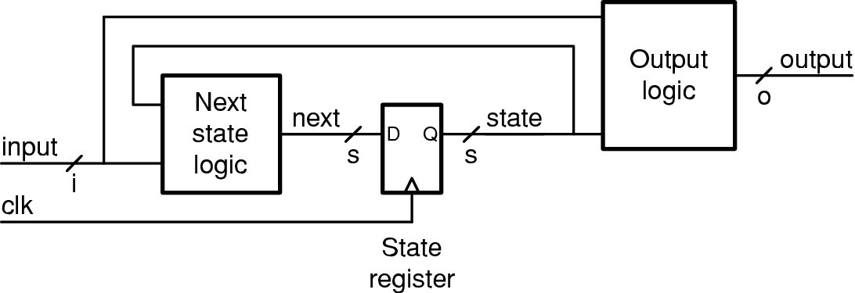
Schematic: Counter as FSM
A simple counter
next_state = rst ? 0 : state + 1
MUX and D-FF can be replaced
By resettable D-FF

Slide 12
Sequential Datapath

Slide 13
An Up/Down/Load (UDL) Counter
A Deluxe Counter that can:
count up (increment)
count down (decrement)
be loaded with a value
Up, down, and load guaranteed to be one-hot. rst overrides.
if rst, next_state = 0 if (!rst & up) next_state = state+1 if (!rst & down) next_state = state-1 if (!rst & load) next_state = in else next_state = state
Notes:
依樣畫葫蘆，擴展到

Slide 14
Table Version
State | Next State
 | rst | up | down | load
0 | 0 | 1 | 31 | in
1 | 0 | 2 | 0 | in
2 | 0 | 3 | 1 | in
. . .
30 | 0 | 31 | 29 | in
31 | 0 | 0 | 30 | in

Slide 15
Symbolic Table Version
State | Next State
 | rst | up | down | load | else
q | 0 | q+1 | q-1 | in | q
State | In | Rst | Up | Down | Load | Next
q | x | 1 | x | x | x | 0
q | x | 0 | 1 | 0 | 0 | q+1
q | x | 0 | 0 | 1 | 0 | q-1
x | y | 0 | 0 | 0 | 1 | y
q | x | 0 | 0 | 0 | 0 | q
Up, down, and load guaranteed to be one-hot. rst overrides
Notes:
Block diagram

Slide 16
module UDL_Count1(clk, rst, up, down, load, in, out) ;
parameter n = 4 ;
input clk, rst, up, down, load ;
input [n-1:0] in ;
output [n-1:0] out ;
wire [n-1:0] out ;
reg [n-1:0] next ;
DFF #(n) count(clk, next, out) ;
always_comb begin
casez({rst, up, down, load})
4'b1???: next = {n{1'b0}} ; //reset
4'b0100: next = out + 1'b1 ;
4'b0010: next = out - 1'b1 ;
4'b0001: next = in ;
4’b0000: next = out ;
default: next = {n{1’bx}} ;//unknown
endcase
end
endmodule
Up or down，需要兩個加減法器，可以更簡化嗎?
State | Next State
 | rst | up | down | load | else
q | 0 | q+1 | q-1 | in | q
Check p.11 async rst

Slide 17
module UDL_Count1(clk, rst, up, down, load, in, out) ;
parameter n = 4 ;
input clk, rst, up, down, load ;
input [n-1:0] in ;
output [n-1:0] out ;
wire [n-1:0] out, outpm1 ;
reg [n-1:0] next ;
DFF #(n) count(clk, next, out) ;
assign outpm1 = out + {{n-1{down}},1'b1} ; // down ? -1 : 1
always@(rst, up, down, load, in, out, outpm1) begin
casez({rst, up, down, load})
4'b1???: next = {n{1'b0}} ;
4'b01??: next = outpm1 ;
4'b001?: next = outpm1 ;
4'b0001: next = in ;
default: next = out ;
endcase
end
endmodule
只用一個加減法器
把可以共用的資源提出來
Quiz: what’s the difference
Between these 2 coding examples?
Check p.11 async rst

Slide 18
Schematic of UDL Counter
Data path
State | Next State
 | rst | up | down | load | else
q | 0 | q+1 | q-1 | in | q
Controller

Slide 19
EXERCISE- Divide by 3 with Data Path
Output: (out) goes high once for each third cycle that input (in) is high
Example
IN: 0101010011100
OUT: 0000001000010
Note one cycle delay
Draw the data path
What arithmetic operators are demanded?
What are the inputs and outputs?
What are the control signals?
How do we make the output go high in the same cycle as the third input 1?

Slide 20
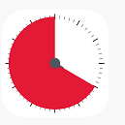
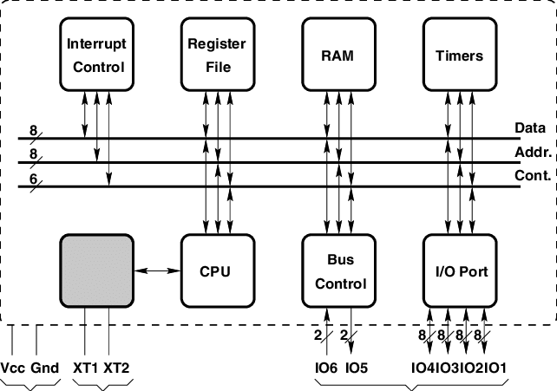
Timer module (Set a Value and Decrease)
load – loads count done – asserted when count = 0 count decrements unless load or done is true
control
flag
8051
controller
Data path: adder+mux+D-FF+comparator
Controller: combinational logic with inputs and flags
Exercise: realize divide-by-3 function on this module (Ex. 16.1)

Slide 21
module Timer(clk, rst, load, in, done) ;
parameter n=4 ;
input clk, rst, load ;
input [n-1:0] in ;
output done ;
wire [n-1:0] count, next_count ;
wire done ;
DFF #(n) cnt(clk, next_count, count) ;
always@(rst, load, in, out) begin
casez({rst, load, done})
3'b1??: next_count = 0 ; // reset
3'b001: next_count = 0 ; // done
3'b01?: next_count = in ; // load
default: next_count = count-1’b1; // count down
endcase
end
assign done = (count == 0) ;
endmodule
Check p.11 async rst

Slide 22
Shift registers

Slide 23
Shift Register (+ Shift left + Shift right)
next_state = rst ? 0 : {state[n-2:0],sin} ;
Exercise: apply MUX to realize shl and shr,
which can be merged with rst.
Quiz: what function can be achieved if D-FF’s are
connected serially with parallel data out?

Slide 24
module Shift_Register1(clk, rst, sin, out) ;
parameter n = 4 ;
input clk, rst, sin ;
output [n-1:0] out ;
wire [n-1:0] next = rst ? {n{1'b0}} : {out[n-2:0],sin} ;
DFF #(n) cnt(clk, next, out) ;
endmodule
Check p.11 async rst
module Shift_Register1(clk, rst, sin, out) ;
parameter n = 4 ;
input clk, rst, sin ;
output [n-1:0] out ;
wire [n-1:0] next;
assign next = {out[n-2:0],sin} ;
always_ff@(posedge clk or posedge rst)
if(rst) out <= {n{1'b0}} ;
else out <= next;
endmodule
A better coding style

Slide 25
module LRL_Shift_Register1(clk, rst, left, right, load, sin, in, out) ;
parameter n = 4 ;
input clk, rst, left, right, load, sin ;
input [n-1:0] in ;
output [n-1:0] out ;
reg [n-1:0] next ;
reg [4:0] out ;
always_ff@(posedge clk or posedge rst)
if(rst) out <=0;
else out <= next;
always_comb begin
casez({left,right,load})
3'b1??: next = {out[n-2:0],sin} ; // left
3'b01?: next = {sin,out[n-1:1]} ; // right
3'b001: next = in ; // load
default: next = out ; // hold
endcase
end
endmodule

Slide 26
Datapath and control partitioning 所有數位設計都可拆成資料流計算與控制兩部分

Slide 27
Datapath/Control Partitioning
Datapath – determined by a function – e.g., mux, arithmetic, … Control – determined by state diagram or state table
Control FSM can be realized by
ROM or instruction memory
Or flags

Slide 28
規格
The vending machine accepts nickels, dimes, and quarters. Whenever a coin is deposited into the coin slot, a pulse appears for one clock cycle on one of three lines indicating the type of coin: nickel, dime, or quarter.
The price of the item is set on an n-bit switch internal to the machine (in units of nickels), and is input to the controller on the n-bit signal price.
When sufficient coins have been deposited to purchase a soft drink, the status signal enough is asserted. Any time enough is asserted and the user press a disperse button; signal serve is asserted for exactly one cycle to serve the soft drink. After asserting serve, the FSM must wait until signal done is asserted, indicating that the mechanism has finished serving the soft drink.

Slide 29
After serving, the machine returns change (if any) to the user. It does this one nickel at a time, asserting the signal change, for exactly one cycle and waiting for signal done to indicate that a nickel has been dispensed before dispensing the next nickel or returning to its original state. Any time the signal done is asserted, we must wait for done to go low before proceeding.

Slide 30
Consider a vending machine controller
規格
Receives coins (nickel, dime, quarter) and accumulates sum 算錢
When “dispense” button is pressed serves a drink if enough coins have been deposited 給飲料
Then returns change – one nickel at a time. 找零
如何設計
給定規格，先定義出資料流計算(datapath)部分和控制訊號(state diagram)兩部分
//given system specs, you need to define both operations (data path) and control signals (state diagram)
Partition task
Datapath – keep track of amount owed user 算錢
Control – keep track of sequence – deposit, serve, change 動作流程

Slide 31
先處理 Datapath: data state
Data state:
amount of money 目前投了多少錢 (in unit of nickels): amount
影響amount的運算
Reset: amount =0;
Deposit a coin: amount = amount + value
Value = 1, 2, 5 for a nickel, dime, or quarter
Return one nickel of change: amount = amount -1
Otherwise: no change

Slide 32
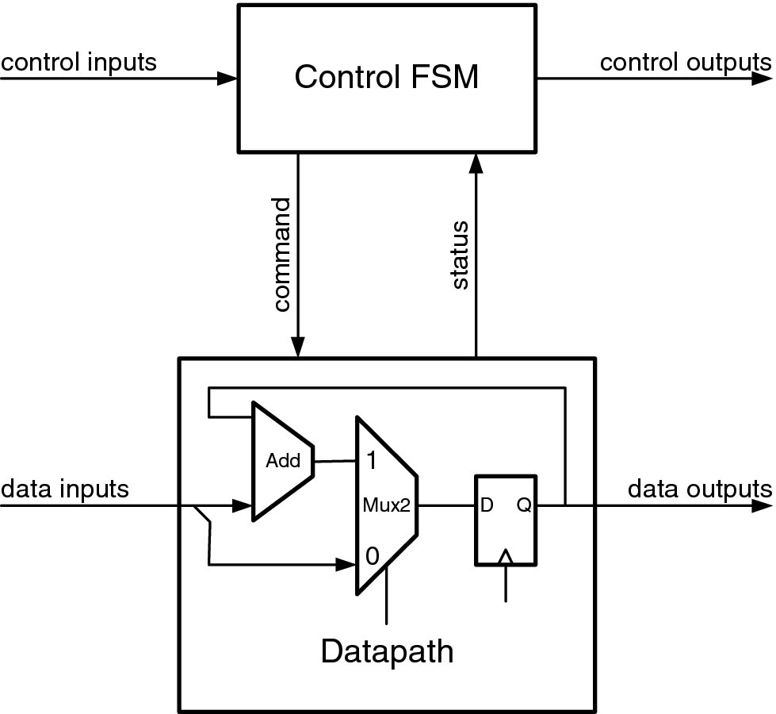
再處理control part: data 改變的時間點
先確定輸出入
輸入
資料 : (nickel, dime, quarter), price
動作: dispense, done
系統: rst, clk
輸出
serve, change
內部Status/command signal
Status: enough, zero
Command: 決定state時一起看

Slide 33
再處理control part :State diagram
In this diagram, edges from a state to itself are omitted. If the conditions on all edges leading out of the current state are not satisfied, the FSM stays in that state.

Slide 34
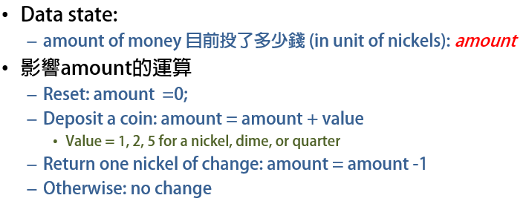
module VendingMachine(clk, rst, nickel, dime, quarter, dispense, done, price,
serve, change) ;
parameter n = `DWIDTH ;
input clk, rst, nickel, dime, quarter, dispense, done ;
input [n-1:0] price ;
output serve, change ;
wire serve, change;
//internal signals
wire enough, zero;
//variable declaration
logic [2:0] value;
logic [n-1:0] amount;
assign value = nickel ? 1 : (dime ? 2 : 5));
assign zero = amount == 0;
assign enough = amount >= price;
always_ff @(posedge clk or posedge rst)
if(rst) amount <= 0;
else amount <= amount_nxt;

Slide 35
//state machine
parameter [2:0] DEPOSIT = 0,
SERVE1 = 1,
SERVE2 = 2,
CHANG1 = 3,
CHANG2 = 4;
reg [2:0] state, state_nxt;
always_ff @(posedge clk or posedge rst)
if(rst == 1) state <= DEPOSIT;
else state <= state_nxt;

Slide 36
always_comb begin
amount_nxt = amount;
state_nxt = DEPOSIT;
serve = 0;
change = 0;
case(state)
DEPOSIT: begin
if(dispense & enough) state_nxt = SERVE1;
else state_nxt = DEPOSIT;
amount_nxt = amount + value;
if(dispense & enough) serve = 1; //when from DEPOSIT to SERVE1
end
SERVE1: begin
if(done) state_nxt = SERVE2;
else state_nxt = SERVE1;
amount_nxt = amount - price;
end

Slide 37
SERVE2: begin
if(~done & zero) state_nxt = DEPOSIT;
else if(~done & ~zero) state_nxt = CHANG1;
else state_nxt = SERVE2;
if(~done & ~zero) change = 1; //when from SERVE2 to CHANG1
end
CHANG1: begin
if(done) state_nxt = CHANG2;
else state_nxt = CHANG1;
amount_nxt = amount - 1;
end
CHANG2: begin
if(~done & ~zero) state_nxt = CHANG1;
else if(~done & zero) state_nxt = DEPOSIT;
else state_nxt = CHANG2;
end
endcase
end
endmodule

Slide 38
Block diagram of data path

Slide 39
//----------------------------------------------------------------------
// VendingMachine - Top level module
// Just hooks together control and datapath
//----------------------------------------------------------------------
module VendingMachine(clk, rst, nickel, dime, quarter, dispense, done, price,
serve, change) ;
parameter n = `DWIDTH ;
input clk, rst, nickel, dime, quarter, dispense, done ;
input [n-1:0] price ;
output serve, change ;
wire enough, zero, sub ;
wire [3:0] selval ;
wire [2:0] selnext ;
//define control generator
VendingMachineControl vmc(clk, rst, nickel, dime, quarter, dispense, done,
enough, zero, serve, change, selval, selnext, sub) ;
//define data path
VendingMachineData #(n) vmd(clk, selval, selnext, sub, price, enough, zero) ;
endmodule
Another coding style: in two modules

Slide 40
//----------------------------------------------------------------------
module VendingMachineControl(clk, rst, nickel, dime, quarter, dispense, done,
enough, zero, serve, change, selval, selnext, sub) ;
input clk, rst, nickel, dime, quarter, dispense, done, enough, zero ;
output serve, change, sub ;
output [3:0] selval ;
output [2:0] selnext ;
wire [`SWIDTH-1:0] state, next ; // current and next state
reg [`SWIDTH-1:0] next1 ; // next state w/o reset
// outputs
wire first ; // true during first cycle of serve1 or change1
wire serve1 = (state == `SERVE1) ;
wire change1 = (state == `CHANGE1) ;
wire serve = serve1 & first ;
wire change = change1 & first ;
// datapath controls
wire dep = (state == `DEPOSIT) ;
// price, 1, 2, 5
wire [3:0] selval = {(dep & dispense),
((dep & nickel)| change),
(dep & dime),
(dep & quarter)} ;
// amount, sum, 0
wire selv = (dep & (nickel | dime | quarter |
(dispense & enough))) |
(change) ;
wire [2:0] selnext = {!(selv | rst),selv,rst} ;
// subtract
wire sub = (dep & dispense) | change ;
// only do actions on first cycle of serve1 or change1
wire nfirst = !(serve1 | change1) ;
DFF #(1) first_reg(clk, nfirst, first) ;
// state register
DFF #(`SWIDTH) state_reg(clk, next, state) ;
// next state logic
always @(state or zero or dispense or done or enough) begin
casex({dispense, enough, done, zero, state})
{4'b11xx,`DEPOSIT}: next1 = `SERVE1 ; // dispense & enough
{4'b0xxx,`DEPOSIT}: next1 = `DEPOSIT ;
{4'bx0xx,`DEPOSIT}: next1 = `DEPOSIT ;
{4'bxx1x,`SERVE1}: next1 = `SERVE2 ; // done
{4'bxx0x,`SERVE1}: next1 = `SERVE1 ;
{4'bxx01,`SERVE2}: next1 = `DEPOSIT ; // ~done & zero
{4'bxx00,`SERVE2}: next1 = `CHANGE1 ; // ~done & ~zero
{4'bxx1x,`SERVE2}: next1 = `SERVE2 ; // done
{4'bxx1x,`CHANGE1}: next1 = `CHANGE2 ; // done
{4'bxx0x,`CHANGE1}: next1 = `CHANGE1 ; // ~done
{4'bxx00,`CHANGE2}: next1 = `CHANGE1 ; // ~done & ~zero
{4'bxx01,`CHANGE2}: next1 = `DEPOSIT ; // ~done & zero
{4'bxx1x,`CHANGE2}: next1 = `CHANGE2 ; // done
endcase
end
// reset next state
assign next = rst ? `DEPOSIT : next1 ;
endmodule

Slide 41
module VendingMachineData(clk, selval, selnext, sub, price, enough, zero) ;
parameter n = 6 ;
input clk, sub ;
input [3:0] selval ; // price, 1, 2, 5
input [2:0] selnext ; // amount, sum, 0
input [n-1:0] price ; // price of soft drink - in nickels
output enough ; // amount > price
output zero ; // amount = zero
wire [n-1:0] sum ; // output of add/subtract unit
wire [n-1:0] amount ; // current amount
wire [n-1:0] next ; // next amount
wire [n-1:0] value ; // value to add or subtract from amount
wire ovf ; // overflow - ignore for now
// state register holds current amount
DFF #(n) amt(clk, next, amount) ;
// select next state from 0, sum, or hold
Mux3 #(n) nsmux({n{1'b0}}, sum, amount, selnext, next) ;
// add or subtract a value from current amount
AddSub #(n) add(amount, value, sub, sum, ovf) ;
// select the value to add or subtract
Mux4 #(n) vmux(`QUARTER, `DIME, `NICKEL, price, selval, value) ;
// comparators
wire enough = (amount >= price) ;
wire zero = (amount == 0) ;
endmodule

Slide 42
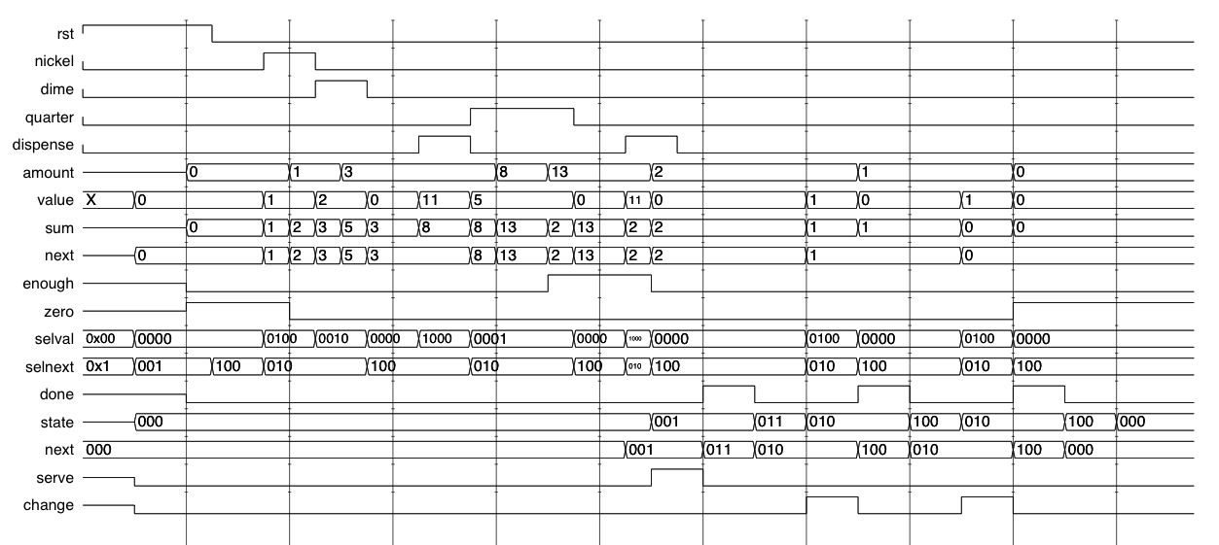
Waveforms for vending machine
Deposit Dime
Deposit Nickel
Attempt Dispense
Dispense
Two Quarters
Serve Drink
Return First Nickel
Return Second Nickel

Slide 43
Summary
Datapath state machines
Next state function specified by an expression, not a table
next = rst ? 0 : (inc ? next + 1 : next) ;
Common “idioms”
Counters
Shift registers
Datapath and control partitioning
Divide state space into control (deposit, serve, change) and data
FSM determines control state
Datapath computes amount
Status and control signals
Special case of factoring
Lead to an arithmetic and logic unit (ALU) in processor designs

